Slide 1
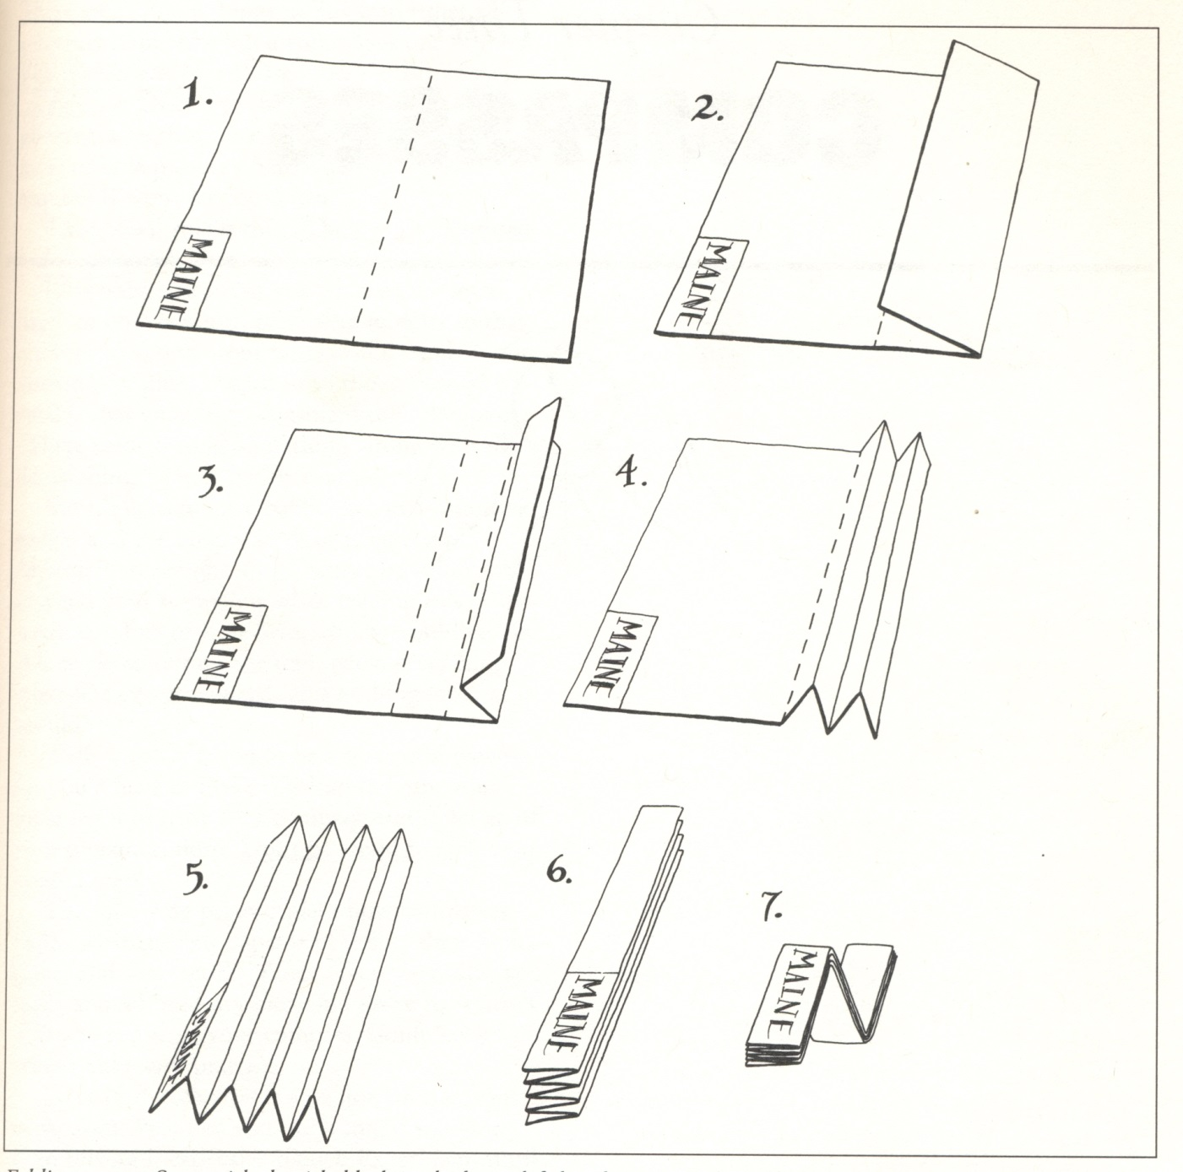
Maps, con’t…
Notes:
Folding
Storage

Slide 2
Route planning
Thinking ahead about routes and alternatives
A valley that offers true solitude can provide an exhilarating experience for the soul.
Just don’t go in there alone.
Jack McDevitt (2011) Firebird.

Slide 3
Route Planning
The Basics…
Select a trip that suits your abilities
Gather Information
Evaluate Routes and Select One (“Map Study”)
Add key waypoints
Notes:
Two Phases of Route Planning: HOME and Field
Select your partners also based on abilities
Information Sources:
MAPS
Websites [Google Earth → Aerial Photos]
Guide Books
Other people
GPX Files
Look at nearly EVERY contour INTERVAL that you will cross
Efficient Route
PERMITS!

Slide 4
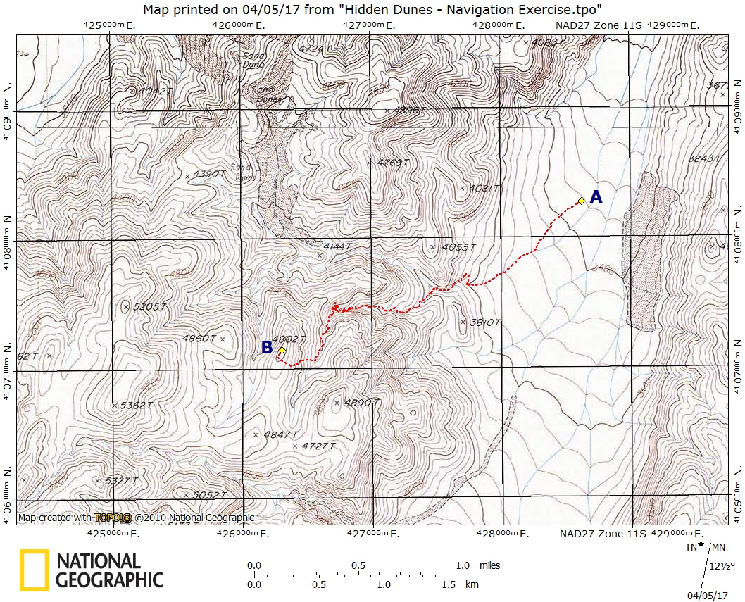
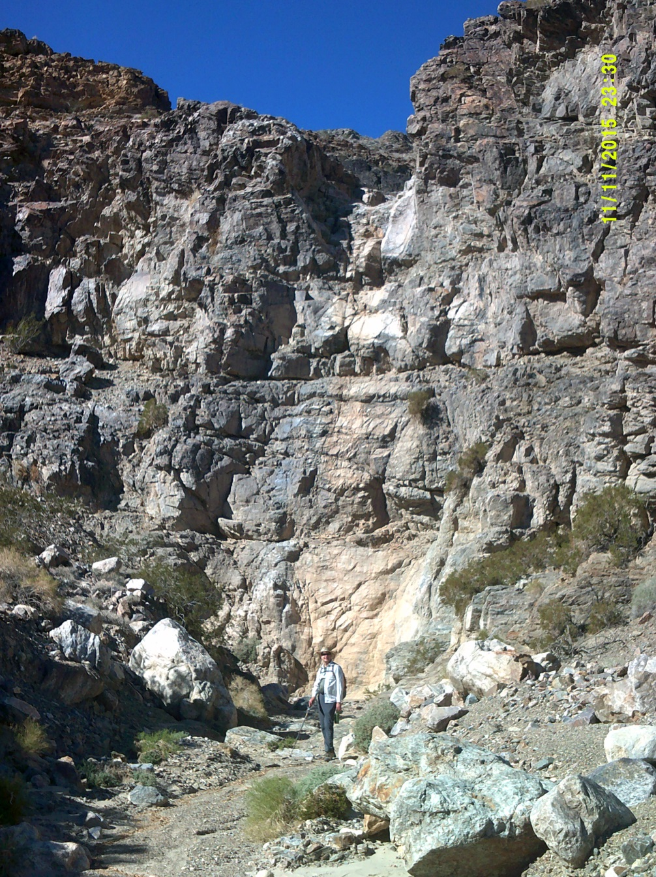
Route Planning

Slide 5
Route Planning Information Types
Elevation gain
Distance
Weather/Seasonal conditions
Notes:
From Clubwide Standards (for Hiking)
Easy → ≤ 8 mi; ≤ 1200 ′ gain
Strenuous → > 14 mi; ≥ 3500 ′ gain

Slide 6
Route Planning Proposing Routes
Estimate the time needed for route segments
Determine the amount of daylight available
Condition, number in the party
Equipment needs
Notes:
Use your travel times!!
Rates:
Elevation gain: 500 – 700 ft/hour when off trail
Speed: ~2mph on trail; <1mph off trail

Slide 7
Route Planning: Terrain Features
Handrails
Baselines
Intentional Offsets
Catch Points
Prominent Peaks

Slide 8
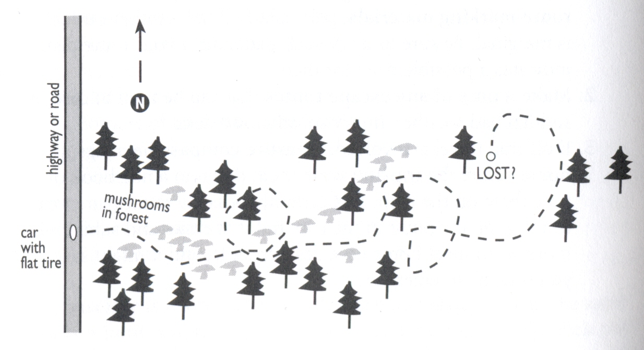
Route Planning: Handrail
Proposed Route Parallels the Handrail
Ref: Burns and Burns (2015), p. 82

Slide 9
Route Planning: Baseline
Hike Due West to the Road/Baseline
Ref: Burns and Burns (2015), p. 82

Slide 10
Route Planning: Intentional Offset or “Aiming Off”
Bearing to Car
~5° Offset
FOUND!
Ref: Burns and Burns (2015), p. 82

Slide 11
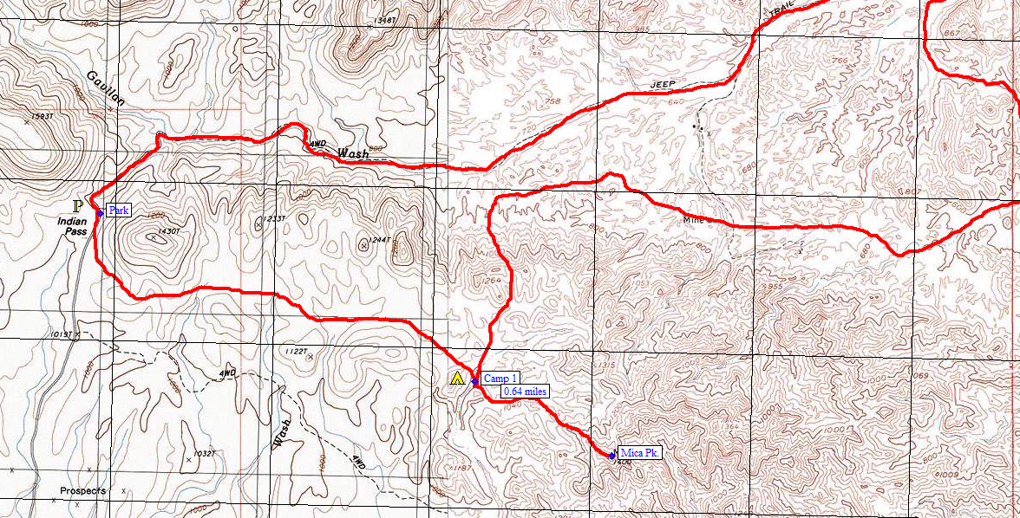
Proposed Route

Slide 12
Route Planning On the Trip
Be Flexible
Turnaround Time
Weather
Confirm route against description
Confirm the time taken for route segments
Available Time
Keep an eye on the party

Slide 13
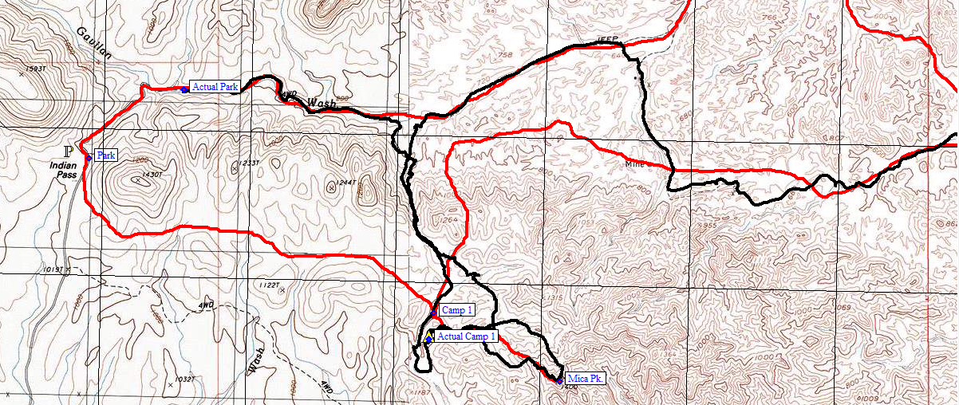
Be Flexible

Slide 14
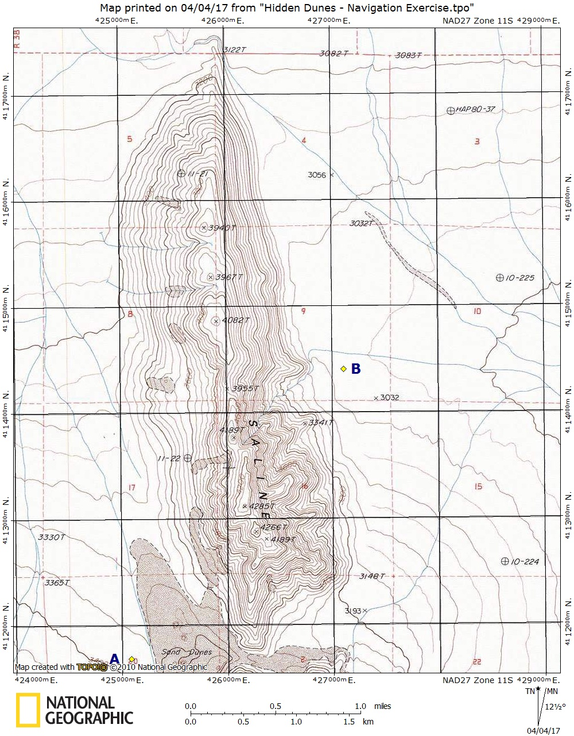
Route Planning Exercise 1
Going northerly from Point A, plot a course to Pt. B

Slide 15
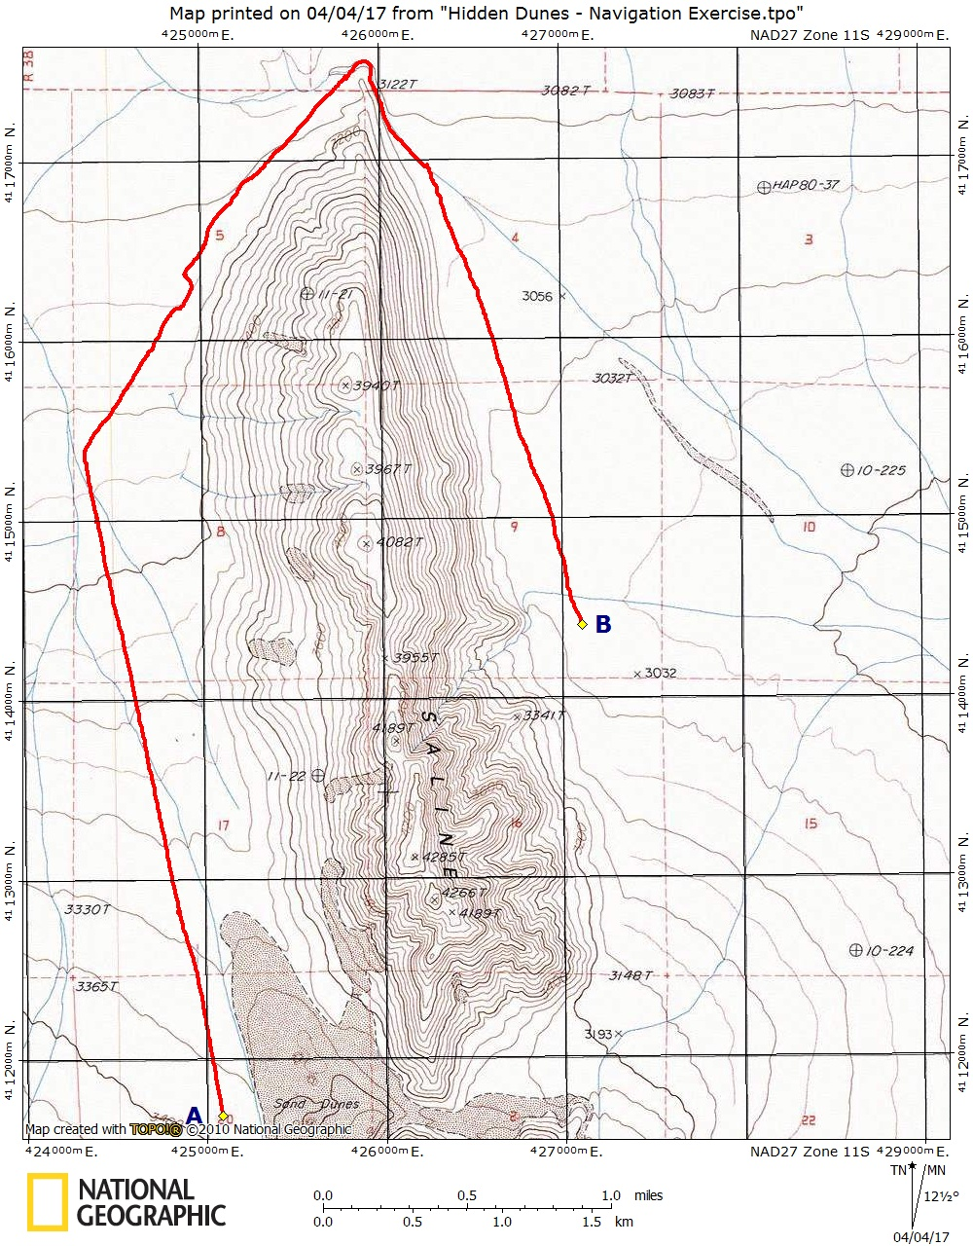
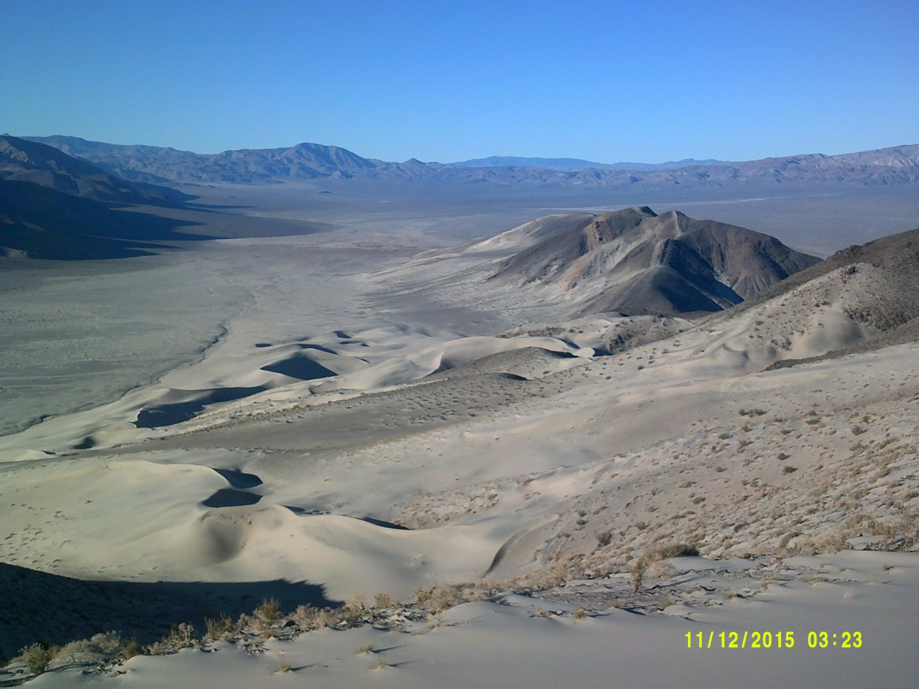
Route Planning Exercise 1
Use ridgeline as a handrail.

Slide 16
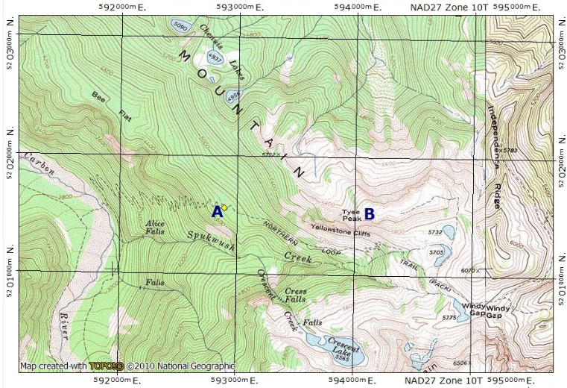
Route Planning Exercise 2
Plot a route from Point A, the trail, to Pt. B, Tyee Peak

Slide 17
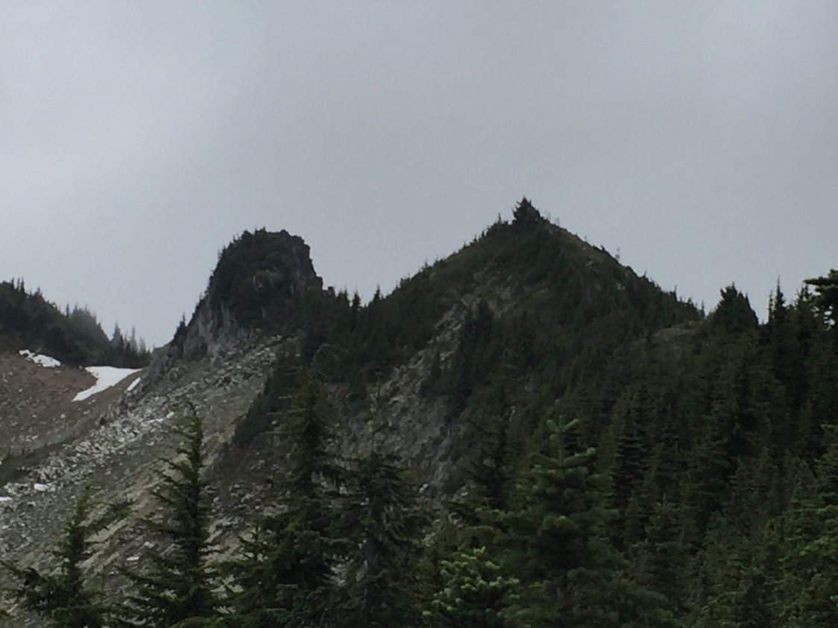
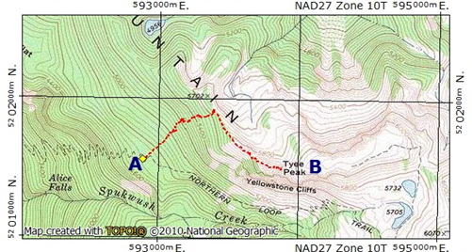
Route Planning Exercise 2
Use ridge as baseline; Follow bearing in forest; Potential to use an intentional offset
Tyee Pk.

Slide 18
Questions?

Slide 19
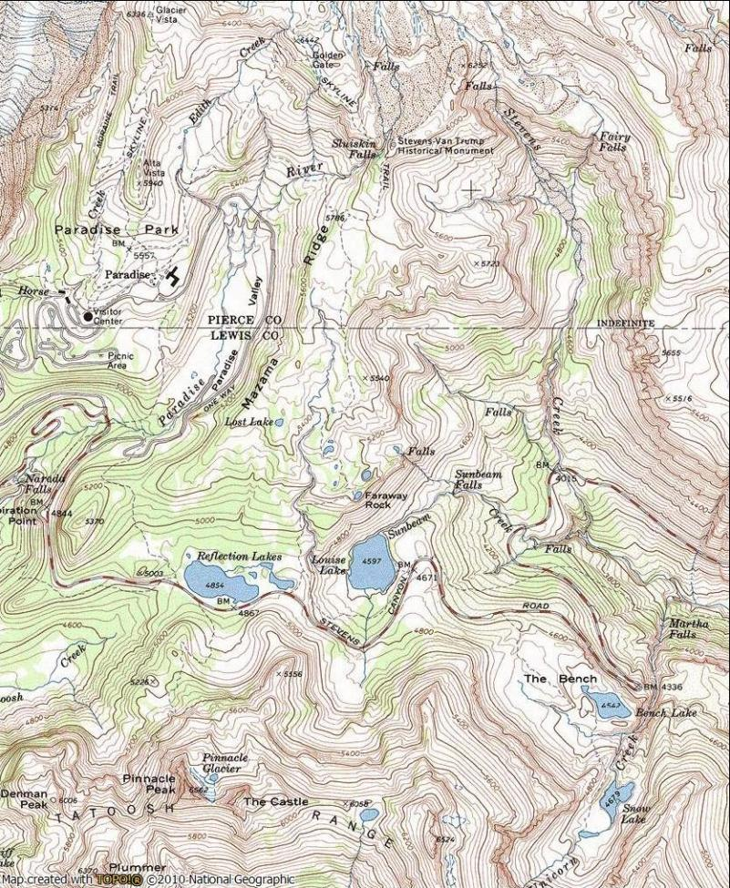
Route Planning
Summer route, using trails

Slide 20
Route Planning
Summer route, using trails, with elevation profile

Slide 21
Route Planning
Winter route, without trails,
with elevation profile

Slide 22
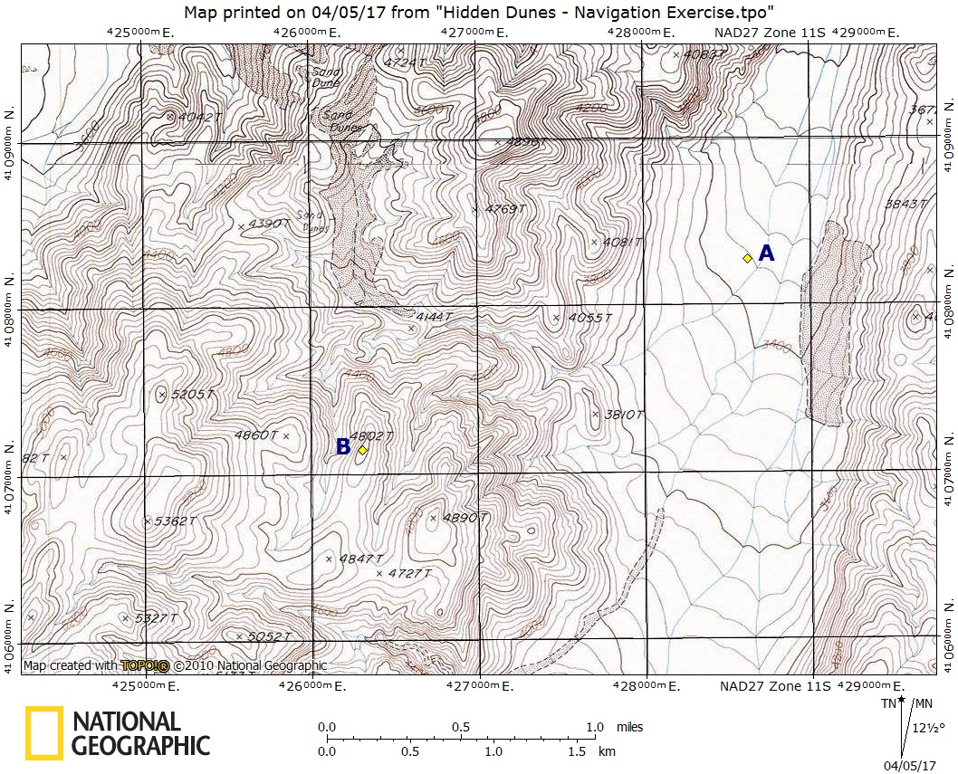
Route Planning Exercise 3
From Point A, plot a course to Pt. B (Pt. 4802)

Slide 23
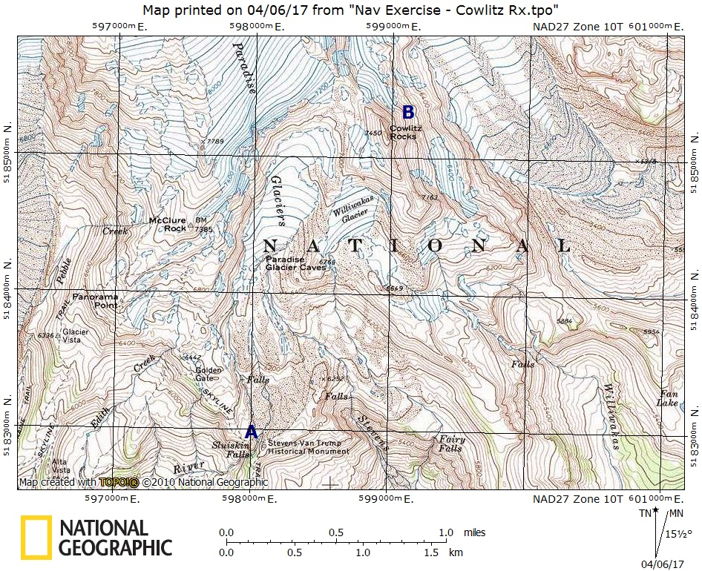
Route Planning Exercise 4
Plot a route from Point A, Van Trump Monument, to Pt. B, Cowlitz Rocks

Slide 24
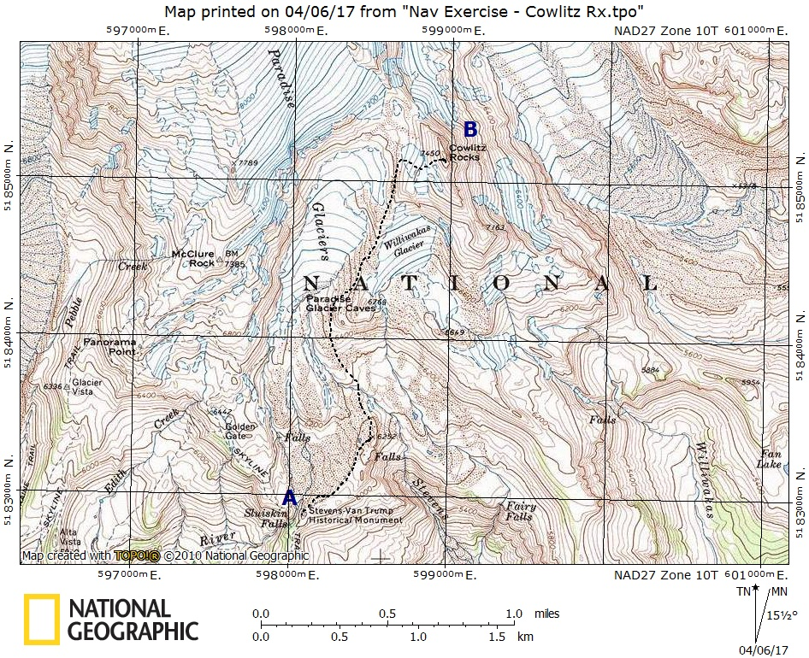
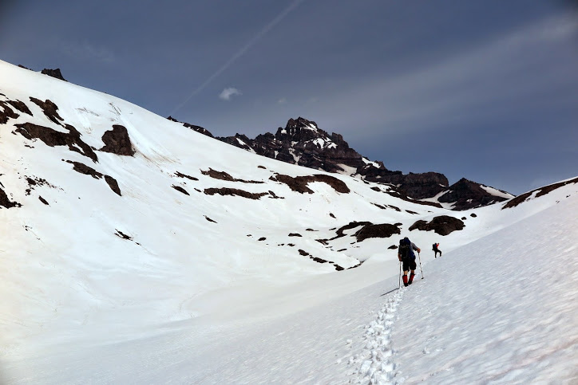
Route Planning Exercise 4
Avoid glaciers; Stevens Creek Crossing

Slide 25
Navigation in a group setting
Being a navigator and how to disagree about location

